Slide 1
ERROR HANDLING

Slide 2
When We Need To Handle Error in SQL Server
Possible scenarios where we can use error handling:
While executing some DML Statement like INSERT, DELETE, UPDATE we can handle the error for checking proper output
If transaction fails, then we need to rollback - This can be done by error handling
While using Cursor in SQL Server

Slide 3
Error Handling Mechanism
The two most common mechanisms for error handling in SQL Server are:
@@ERROR
TRY-CATCH Block

Slide 4
Using @@ERROR
@@Error is a Global Variable in SQL Server.
This variable automatically populates the error message when a certain error occurred in any statement.
But the catch here is we have to trace it within just after the next line where the actual error occurred, otherwise, it will reset to 0.
Returns 0 if no error was generated

Slide 5
Using @@ERROR
SYNTAX :
Select @@ERROR
RETURN TYPE :
int
@@ERROR contains the value from the sys.messages.message_id column for that error.
We can view the text associated with an @@ERROR error number in sys.messages.

Slide 6
Using @@ERROR
EXAMPLE

Slide 7
When We Should Use @@Error
There are some scenarios where we should use @@ERROR:
With Insert, Delete, Update, Select Into Statement.
While using Cursor in SQL Server (Open, Fetch Cursor).
While executing any Stored Procedure

Slide 8
TRY...CATCH (Transact-SQL)
Implements error handling for Transact-SQL that is similar to the exception handling .
This is available from SQL Server 2005 Onwards
A group of Transact-SQL statements can be enclosed in a TRY block .
If an error occurs in the TRY block , control is passed to CATCH block

Slide 9
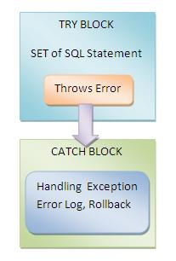
TRY...CATCH (Transact-SQL)

Slide 10
TRY...CATCH (Transact-SQL)
SYNTAX :
BEGIN TRY
{ sql_statement | statement_block }
END TRY
BEGIN CATCH
[ { sql_statement | statement_block } ]
END CATCH
[ ; ]
A TRY…CATCH construct catches all execution errors that have a severity higher than 10 that do not close the database connection.

Slide 11
TRY...CATCH (Transact-SQL)
EXAMPLE

Slide 12
TRY...CATCH (Transact-SQL)
PREDICT OUTPUT :
BEGIN TRY
SELECT 1
UNION ALL
SELECT 2
UNION ALL
SELECT NULL
END TRY
SELECT * FROM StudentDetails
BEGIN CATCH
PRINT ‘ ERROR !!’
END CATCH

Slide 13
TRY...CATCH (Transact-SQL)
OUTPUT :
SYNTAX ERROR !!!
REASON :
Including any other statements between the END TRY and BEGIN CATCH statements generates a syntax error.

Slide 14
TRY...CATCH (Transact-SQL)
A TRY…CATCH construct cannot
a) span multiple batches.
b) span multiple blocks of Transact-SQL statements.
c) be used with user-defined functions.

Slide 15
TRY...CATCH (Transact-SQL)
Errors trapped by a CATCH block are not returned to the calling application.
To do so ,we have to use any of the following
i) SELECT result sets
ii) RAISERROR
iii) PRINT statements.
To get the details of the error SQL Server provides the System functions that we can use for retrieving the details of the error.

Slide 16
TRY...CATCH (Transact-SQL)
EXAMPLE 1
EXAMPLE 2

Slide 17
TRY...CATCH (Transact-SQL)
OUTPUT :
ErrNumber | 8134
ErrSeverity | 16
ErrState | 1
ErrProc | NULL
ErrLine | 2
ErrMessage | Divide by zero error encountered.

Slide 18
TRY...CATCH (Transact-SQL)
ERROR_NUMBER() returns the number of the error.
ERROR_SEVERITY() returns the severity.
ERROR_STATE() returns the error state number.
ERROR_PROCEDURE() returns the name of the stored procedure or trigger where the error occurred.
ERROR_LINE() returns the line number inside the routine that caused the error.
ERROR_MESSAGE() returns the complete text of the error message. The text includes the values supplied for any substitutable parameters, such as lengths, object names, or times.

Slide 19
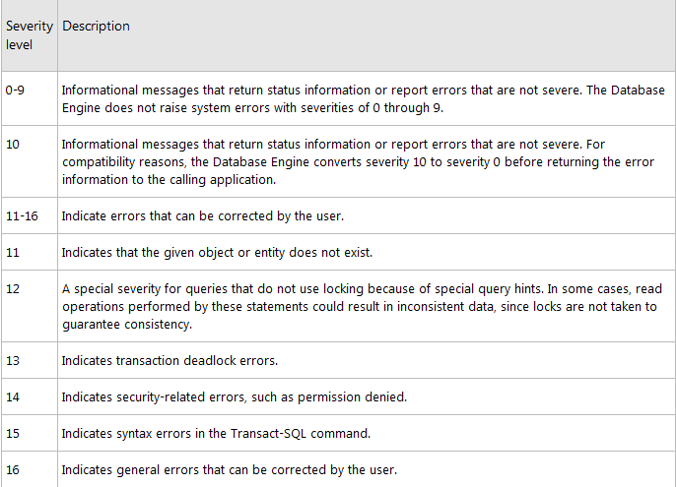
ERROR_SEVERITY()

Slide 20
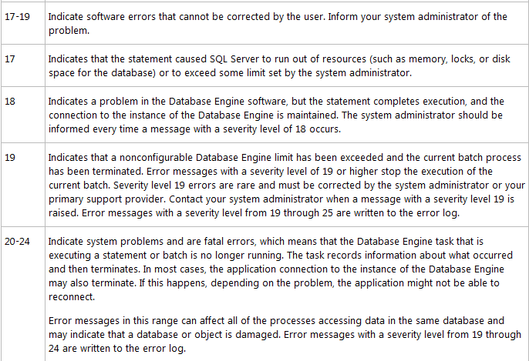
ERROR_SEVERITY()

Slide 21
User-Defined Error Message Severity
sp_addmessage can be used to add user-defined error messages with severities from 1 through 25 to thesys.messages catalog view
user-defined error messages can be used by RAISERROR
SYNTAX :
sp_addmessage [ @msgnum= ] msg_id , [ @severity= ] severity , [ @msgtext= ] 'msg' [ , [ @lang= ] 'language' ] [ , [ @with_log= ] { 'TRUE' | 'FALSE' } ] [ , [ @replace= ] 'replace' ]

Slide 22
User-Defined Error Message Severity
[ @msgnum= ] msg_id → integer between 50,001 and 2,147,483,647 .
[ @severity = ]severity →smallint with a default of NULL.
[ @msgtext = ] 'msg' → nvarchar(255) with a default of NULL.
[ @lang = ] 'language' →Is the language for this message.
[ @with_log = ] { 'TRUE' | 'FALSE' } → varchar(5) with a default of FALSE.
[ @replace = ] 'replace' →varchar(7) with a default of NULL.

Slide 23
ERROR FUNCTIONS
These functions return NULL if they are called outside the scope of the CATCH block.
These functions returns error occurred regardless of the number of times it is called or where it is called within the scope of the CATCH block.
Hence these are better and more flexible than, @@ERROR (sounds familiar ??)

Slide 24
TRY…CATCH with RAISERROR
RAISERROR can be used in either the TRY or CATCH block of a TRY..CATCH construct to affect error-handling behavior.
RAISERROR can be used to return information to the caller about the error that caused the CATCH block to execute.
the error number for RAISERROR must be >= 50000.
RAISERROR that has a severity 10 or lower returns an informational message to the calling batch or application without invoking a CATCH block.

Slide 25
RAISERROR
SYNTAX :
RAISERROR ( { msg_id | msg_str | @local_variable } { ,severity ,state } [ ,argument [ ,...n ] ] ) [ WITH option [ ,...n ] ]
msg_str
Is a user-defined message with formatting similar to the printf function in the C standard library.

Slide 26
EXAMPLE
RAISERROR (N'This is message %s %d.', -- Message text. 10, -- Severity,
1, -- State,
N'number', -- First argument.
5); -- Second argument.
-- The message text returned is: This is message number 5. GO

Slide 27
THROW (Transact-SQL)
Raises an exception and transfers execution to a CATCH block of a TRY…CATCH construct in SQL Server 2012 .
SYNTAX :
THROW [ { error_number | @local_variable },
{ message | @local_variable },
{ state | @local_variable } ]
[ ; ]
If a TRY…CATCH construct is not available, the session is ended. The line number and procedure where the exception is raised are set. The severity is set to 16.
If the THROW statement is specified without parameters, it must appear inside a CATCH block.

Slide 28
EXAMPLE
THROW 51000, 'The record does not exist.', 1;
EXAMPLE TO RAISE AN EXCEPTION AGAIN USING THROW

Slide 29
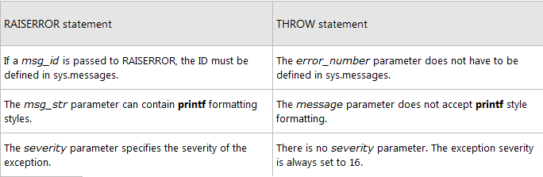
DIFFERENCES BETWEEN RAISERROR AND THROW

Slide 30
Errors Unaffected by a TRY…CATCH Construct
TRY…CATCH constructs do not trap the following conditions:
Warnings or informational messages that have a severity of 10 or lower.
Errors that have a severity of 20 or higher that stop the SQL Server Database Engine task processing for the session.
Attentions, such as client-interrupt requests or broken client connections.
When the session is ended by a system administrator by using the KILL statement.

Slide 31
Errors Unhandled by a TRY…CATCH Construct
Compile errors, such as syntax errors, that prevent a batch from running.
Errors that occur during statement-level recompilation, such as object name resolution errors that occur after compilation because of deferred name resolution.
SOLUTION :
Placing the code in a stored procedure or by executing a dynamic Transact-SQL.

